Slide 1
Data Structures
Doubly Linked Lists

Slide 2
A doubly linked list is a linked list in which every node has a next pointer and a previous (back) pointer.
Each node of a doubly linked list has three parts: Data (Info), Next, and Prev.
Every node contains the address of the next node (except the last node), and the address of the previous node (except the first node).
The beginning of the list is indicated with the help of a special pointer called head (First).
The end of the list is indicated with the help of a special pointer called last.
A doubly linked list can be traversed in either direction. The list can be traversed starting at the first node or, the list can be traversed starting at the last node.

Slide 3
struct node {
struct node *prev; int data;
struct node *next; };

Slide 4
Doubly Linked List Operations
Insert
The insert operation in a doubly linked list is performed in the same manner as a singly linked list.
The only exception is that the additional node pointer Prev is also required to be updated for the new node at the time of insertion.

Slide 5
Insertion in the beginning
Create new_node.
Set the previous pointer of the new_node to null.
Set the next pointer of the new_node to point to the head. new_node-<next=head
Set the head previous pointer to point to the new_node head-<prev=new_node
Set the head to point to the new_node
head=new_node.

Slide 6
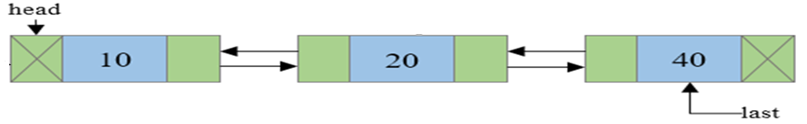
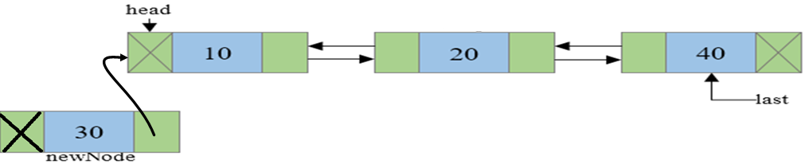
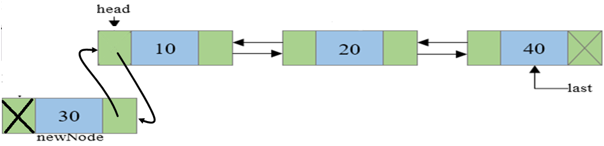
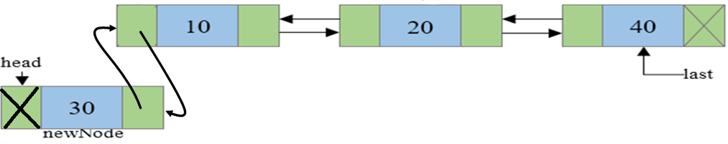

Slide 7
Insertion in specific position
Traverse to N-1 node in the list. Where N is the position to insert. Use a temp variable to point to N-1th node.
Create new_node.
Connect the next pointer of new_node with the node pointed by next of temp node.
Connect the previous of new_node with the temp node.
Connect the previous of the node pointed by temp->next to new_node.
temp->next-<prev= new_node
Connect the next of temp node to new_node
temp->next = new_node.

Slide 8
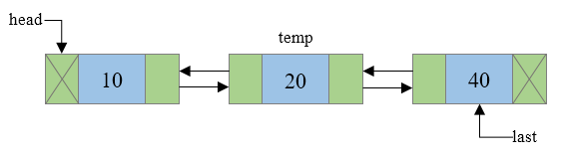
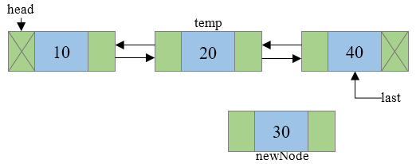
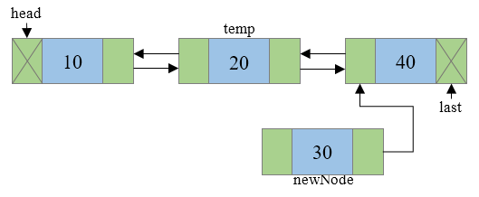

Slide 9
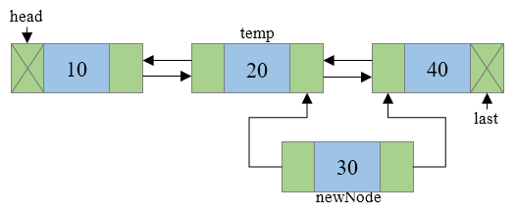
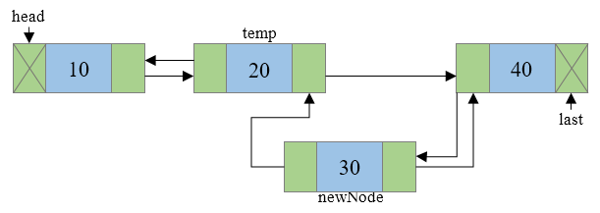
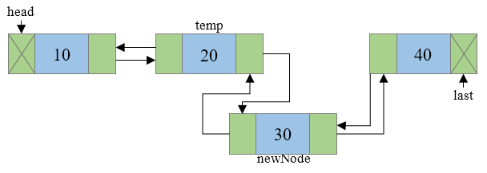
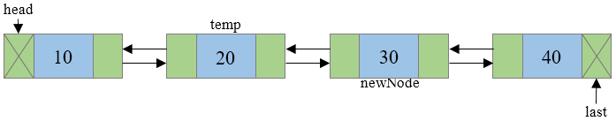

Slide 10
Insertion in the end
Create new_node.
Set the new_node next pointer to null.
Set the last next pointer to point to the new_node
last-<next=new_node
Set the new_node previous pointer to point to the last new_node-<prev=last
Set last to point to the new_node.

Slide 11
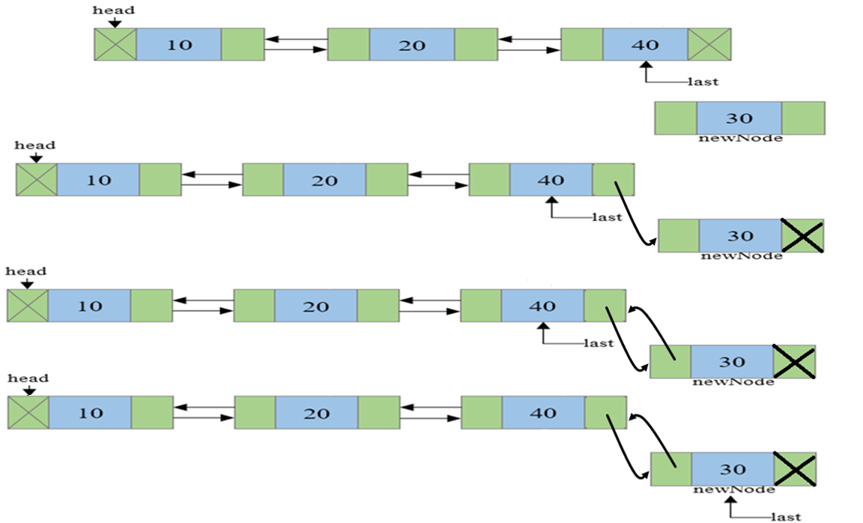

Slide 12
Delete
The delete operation in a doubly linked list is performed in the same manner as a singly linked list.
The only exception is that the additional node pointer prev of the adjacent node is also required to be updated at the time of deletion.

Slide 13
Delete from beginning
Set temp pointer to point to the head of the list.
If the next of the head = null, (one node):
head=null, last=null.
goto 5
Set the head to point the next node head = head ->next.
Set head previous pointer to null
head-<prev=null
Free(temp).

Slide 14
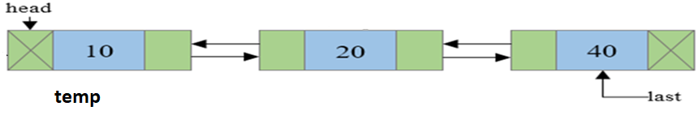
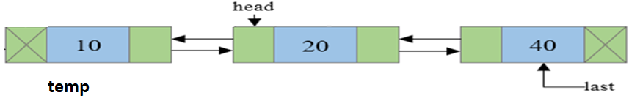
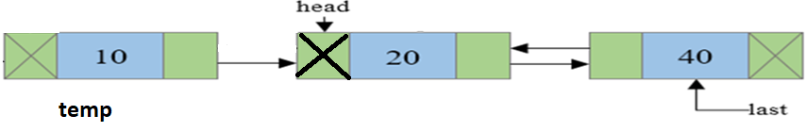

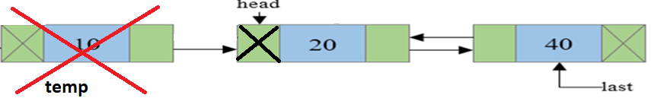

Slide 15
Delete from specific position
Traverse to that node (nth node). Call it current.
Link the node behind current node with the node ahead of current node which can be implemented as: current->prev->next = current->next.
If n+1th node is not NULL(i.e., if current node is not the last node) then link the n+1th node with n-1th node
current->next->prev = current->prev.
Free(current).

Slide 16
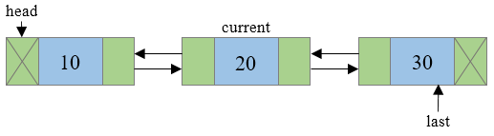
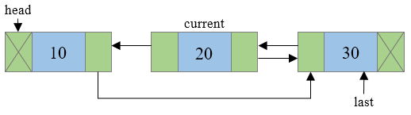
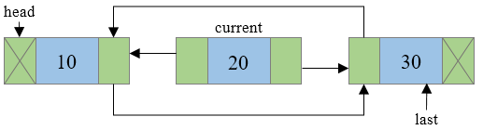
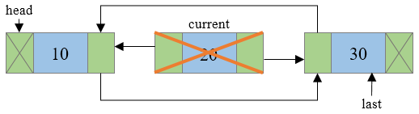
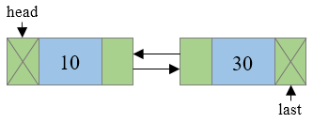

Slide 17
Delete from the end
Set temp to point to last.
Set the last pointer to point to the previous node last = last->prev.
Set the next pointer of the last node to null.
Free(temp).

Slide 18
